Slide 1
Reading Level Identification Using Natural Language Processing Techniques
William Arnost, Ellen Lull, Joseph Schueder
Advisor: Dr. Joseph Engler
Capstone Professor: Jacquelyn Cheun-Jensen

Slide 2
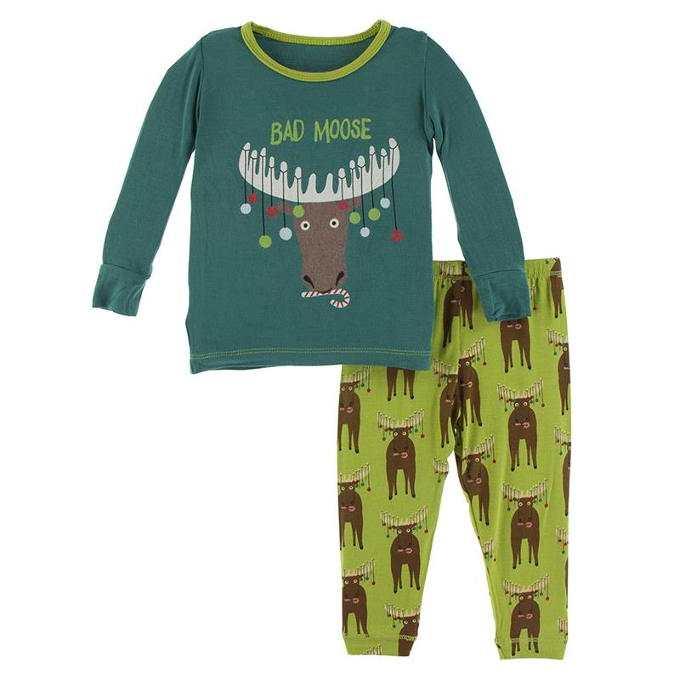
What is Readability?
Karl saw a moose in his pajamas

Slide 3

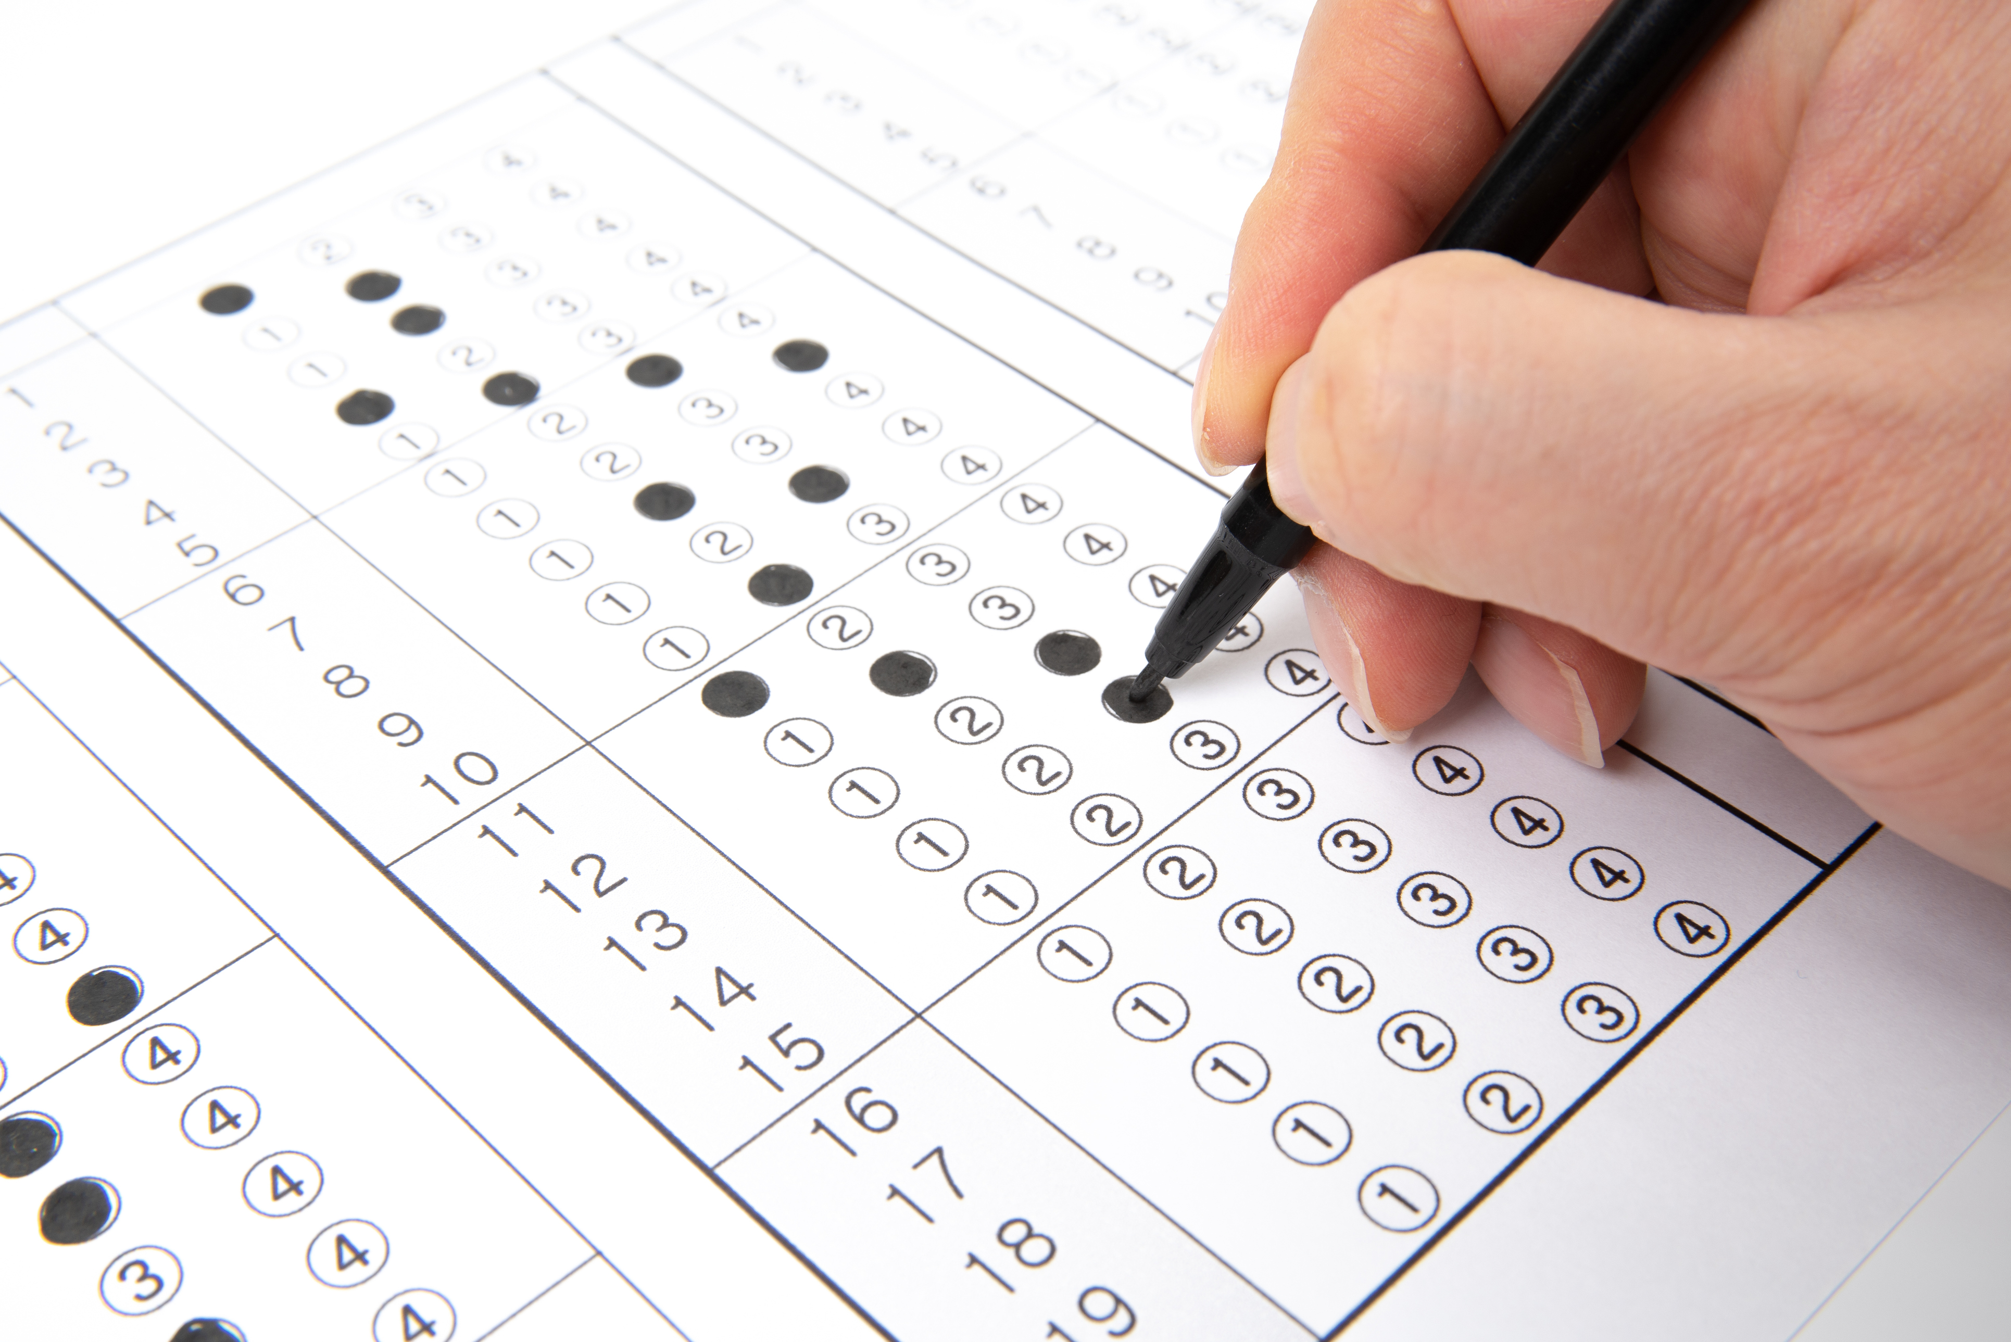

Why Readability Matters
Literacy is a major factor impacting various aspects of an individual’s life.
Literacy affects local, national and world economies.
Writing at an appropriate reading level makes is easier to convey information.
Notes:
Literacy is a major factor impacting various aspects of an individual's quality of life and even affecting local, national, and world economies. For an individual, their ability to read is the primary building block for learning other subject areas. For example, proficiently reading material on science, geography, or math will allow the student to learn much more efficiently and deeply than hearing a lecture or watching a video on a given topic.
Average reading scores are declining in the United States for grades 4, 8, and 12 [31,32]. Classifying texts into different reading levels can assist students in improving their reading skills. The theory is that a reader will improve by choosing a text slightly above their current reading level. This level is often called their "frustration level" as opposed to a "comfort level." Matching students with texts that are challenging but comprehensible can assist in attaining reading skills [35].

Slide 4
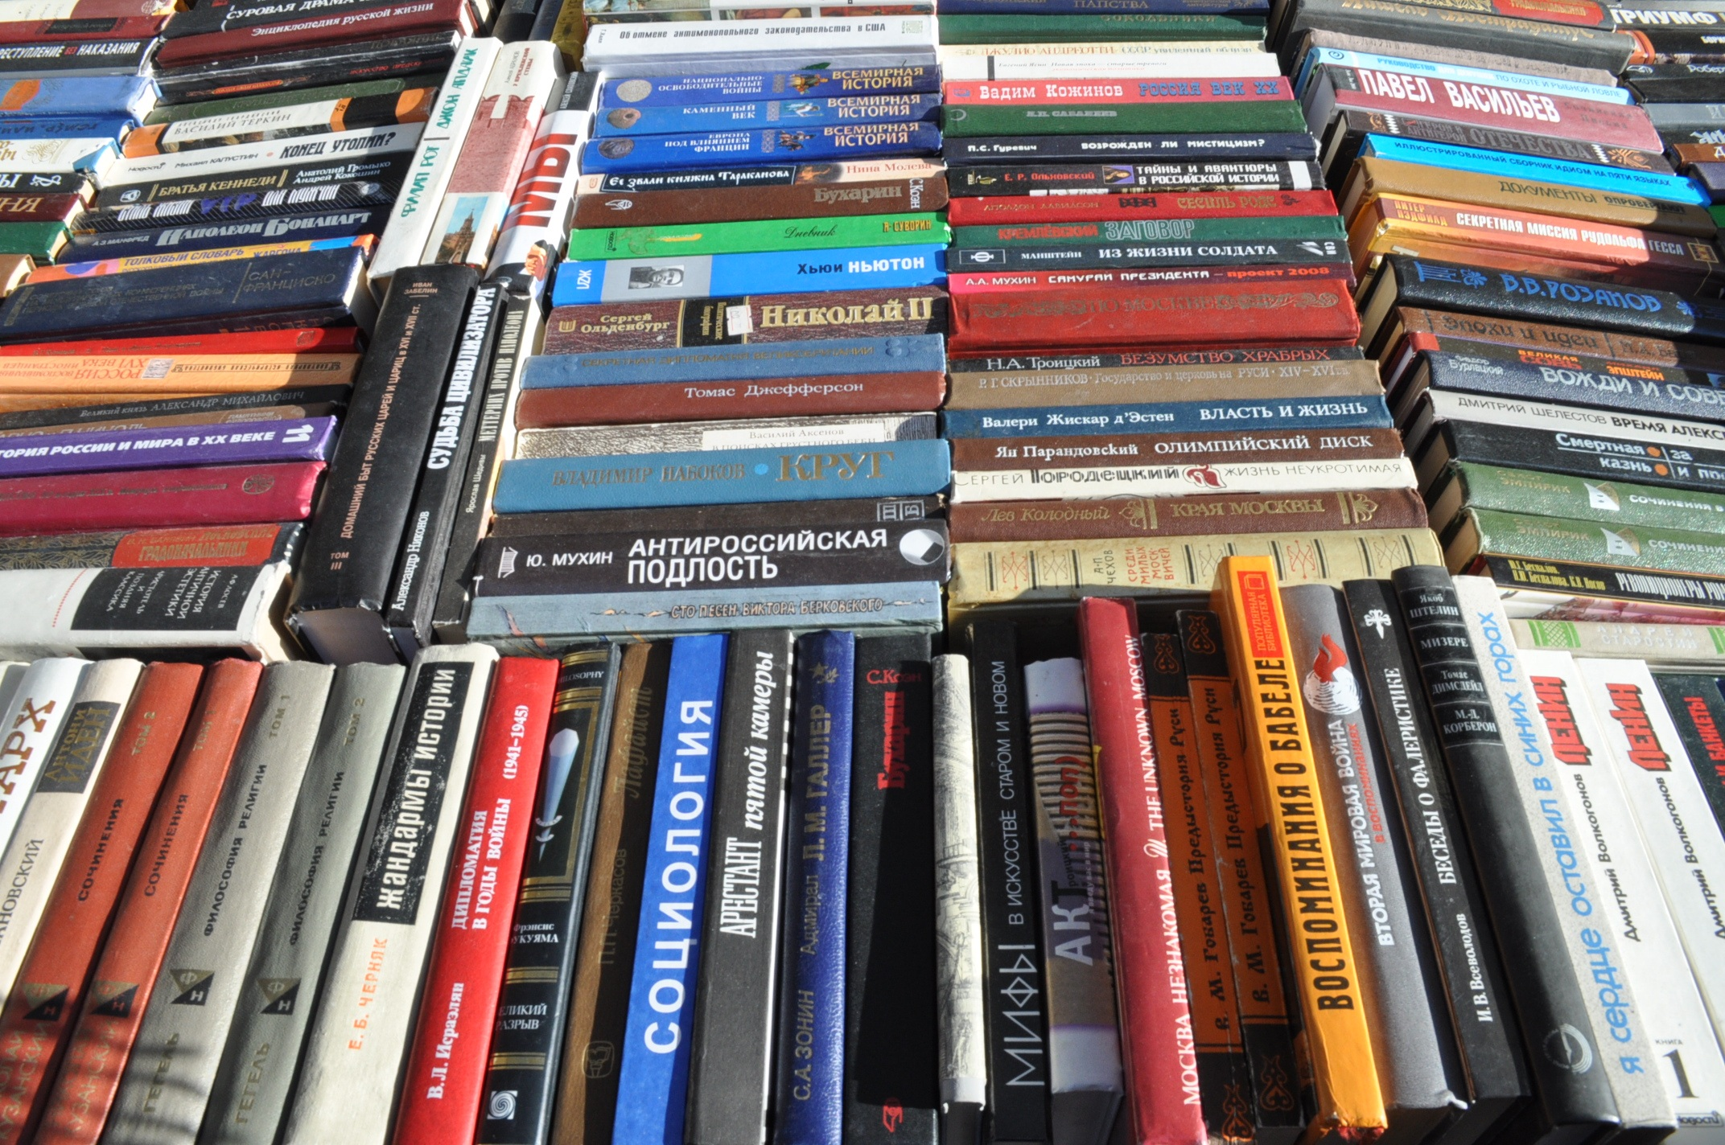
Popular Readability Models
Bradley-Terry Method
Flesch-Kincaid Grade Level
Dale-Chall
Coleman-Laiu Index
Smog
Notes:
The Flesch-Kincaid reading level is the most popular method of calculating readability. As you can see from the formula on this slide, it is a simple formula using the number of words, number of sentences and number of syllables per word. There are several formulas that are similar in concept. The Dale-Chall formula has a list of 3000 words that are considered to be easily ready by a 4th grade level reader. Other words are considered to be more difficult and are calculated into an arithmetic formula.
The Bradley-Terry score is computed by ranking text documents by comparing the documents to each other in a pairwise manner [30]. A person ranks which document "wins" by being easier to read than another document.

Slide 5
Statistical Measures Have Weaknesses
Original
Scrambled
Edwin has two doves. They were given to him by his uncle. He has a nice little house for them. There are two doors in it, where they go in and out. In front of the doors there is a shelf, on which they perch...
Two has doves Edwin. Uncle by given him they his were to. Nice house a little has for them he. It are go there two in where and , out in doors they. A, is they which In on shelf front perch the of doors are ; there...
Flesch Kincaid Grade Level:
2

Slide 6



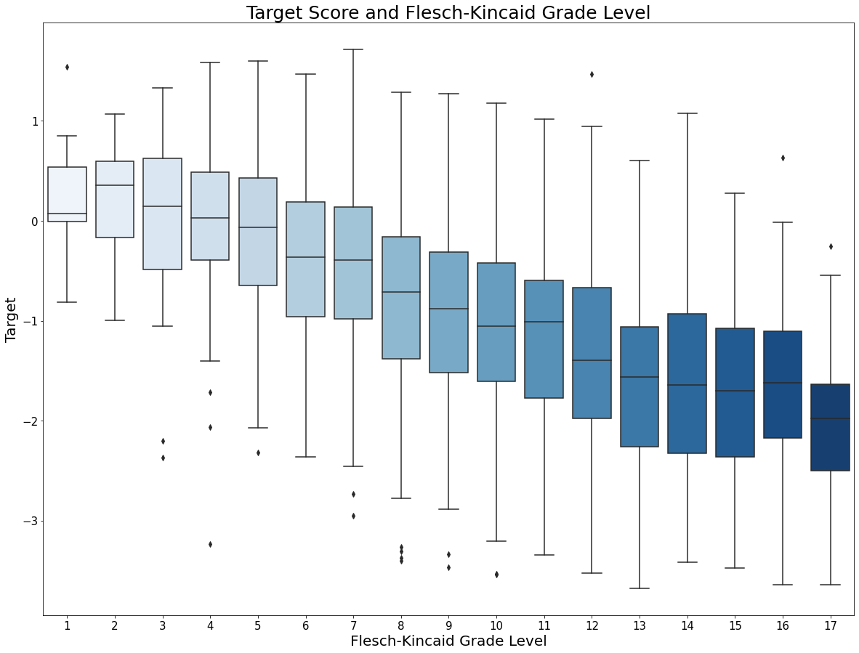
Training Data
Base data from Kaggle competition sponsored by CommonLit with ~2800 training documents and ~2000 test documents
Target value based on Bradley-Terry
Added readability features including:
Flesch-Kincaid
Dale-Chall
Gunning Fog
Coleman-Liau
Lexical Diversity
Complex Words
Named Entities
Notes:
Our training data started with data from a Kaggle competition. The Kaggle competition was created by Dr Scott Crossley of Georgia Stat university to benefit CommonLit. CommonLit is a non-profit organization dedicated to helping Title 1 Students achieve reading proficiency. It provides free reading and writing lessons to over 20 million teachers and students. The target value of this data was a readability score between –3 and 3 which was calculated using a Bradley-Terry method. As discussed earlier, the Bradley-Terry score is computed by a pairwise ranking method and has human intervention. To augment this training data, we ran the passages through the python Readability package and added in other common reading metrics including: Flesch-Kincaid Scores, Dale-Chall Scores, Coleman-Liau index and the Gunning fog readability index. The values of the features from the readability package were all closely correlated and also showed

Slide 7

Improving on the Traditional

Slide 8


Project Goals
Correct deficiencies in current methods
Use Natural Language Processing Techniques​
Machine Learning to include traditional metrics ​

Slide 9
Methods Explored
Graph Convolutional Network
Random Forest
BERT
Many BERTs
Multimodal BERT

Slide 10
Graph Convolutional Network
Document B
Readability:0.1
Document D
Readability:-1.1
Lexical Diversity, Named Entities
Document A
Readability:0.3
Lexical Diversity, FK Score
Vocab Size, Named Entities
Lexical Diversity, Complex Words
Lexical Diversity, Complex Words
Document C
Readability:-0.5
Document E
Readability:-1.3

Slide 11
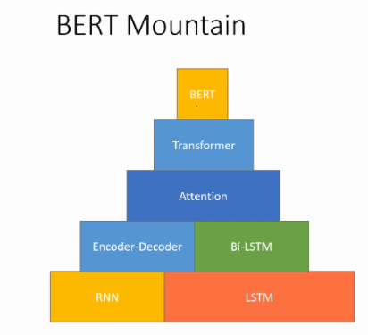
BERT Model Bidirectional Encoder Representation from Transformers
Source: https://msank00.github.io/blog/2020/04/13/blog_607_Survey_BERT

Slide 12
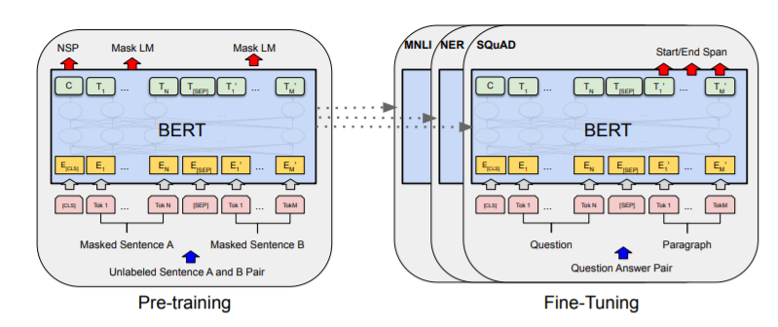
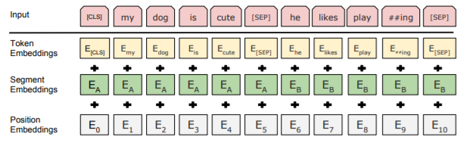
BERT - Pretraining
Source: BERT [Devlin et al., 2018], with modifications

Slide 13
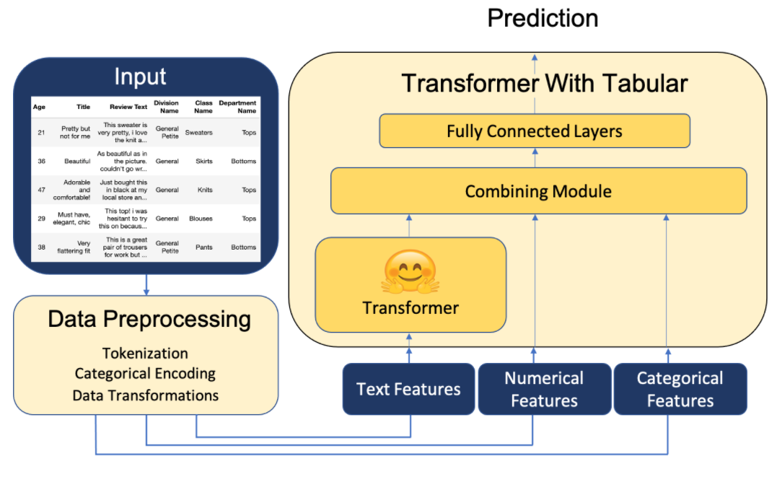
BERT ++ (Multimodal Transformers)
Source: https://github.com/georgian-io/Multimodal-Toolkit

Slide 14
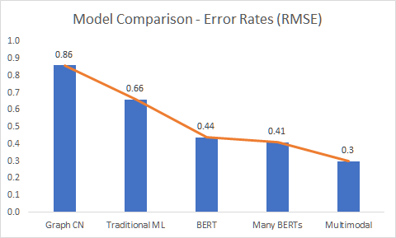
Results
The new model provides a 53 percent improvement

Slide 15

Ethical Considerations
Automated Readability Does Not Consider:
Gender or Cultural Bias of text
Impolite language
Topics not appropriate for younger children

Slide 16
Future Research
Content Moderation
BERT Bias Research
WordNet or Lexical Database
Accessibility: Web Interface / Publicity
Non-English Languages
Graph Model

Slide 17

Conclusion
Our Model:
Is an accurate and reliable way to predict readability of text.
Corrected for deficiencies in current methods
Used natural language processing techniques
Used machine learning to include traditional metrics

Slide 18

Questions?

Slide 19
Citations
Scott Crossley. (May2021). CommonLit Readability Prize. 1. Retrieved May 20,2021 from https://www.kaggle.com/c/commonlitreadabilityprize/overview.
National Association of Educational Progress (2019) NAEP Report Card: 2019 NAEP Reading Assessment, Highlighted results at grade 12 for the nation. https://www.nationsreportcard.gov/highlights/reading/2019/g12/
DiMascio, Carmine “Determine the “Readability” of a text with Python” (2019) https://levelup.gitconnected.com/determine-the-reading-level-of-a-text-with-python-d2f9dccee6bf
“Readability Formulas “ (2021) Web. https://readabilityformulas.com/
Johnson, Patricia. “Effects on Reading Comprehension of Language Complexity and Cultural Background of a Text.” TESOL quarterly 15.2 (1981): 169–181. Web.
hn, Jaimeen, and Alice Oh. “Mitigating Language-Dependent Ethnic Bias in BERT.” (2021): n. pag. Print.

